Slide 1







Developing a Network Security Model

Slide 2


At the end, the fellow should:
Understand the model for network security.
Know the four basic tasks in designing a particular security service
Understand the basics and types of cryptography
Know the importance of encryption and decryption

Slide 3



01
Network Security Model

Slide 4



What is Network Security?
Network security is the practice of protecting data and resources in a network from unauthorized access, misuse, or theft.
The objective is to ensure the confidentiality, integrity, and availability of data.
Robust network security measures safeguard network availability and provide layered defences against a range of cyber threats that can exploit vulnerabilities to breach networks and steal critical data.

Slide 5
What is a Network Security Model?
A network security model in computer networks refers to the structured defensive mechanisms and protocols implemented to protect the confidentiality, integrity and availability of data transmitted between devices over an interconnected system of networks.
Its core purpose of computer network security (CNS) is to transform plain text data into encrypted ciphertext before sending it over the vulnerable network channel so that potential attackers cannot decipher or make sense of the information.

Slide 6
Network Security Model
This is achieved by applying a cryptographic algorithm powered by a secret key known only to the communicating parties in the network security model in CNS. The encrypted data gets transmitted and later decrypted at the receiving end with the same secret key.

Slide 7
Aspects of an effective Network Security Model
Building Blocks of a Network Security Model
Algorithm Design: An encryption algorithm encodes plaintext into ciphertext and decodes cypher text back into plain text. The algorithm’s strength relies on its ability to withstand cracking attempts by adversaries.
Secret Information Generation: Creation of cryptographic keys to protect data.
Key Distribution Methods: A trusted third party facilitates the secret key exchange in the network security model in CNS.
Protocols: Establish communication rules (e.g., TLS) to manage secure connections.

Slide 8
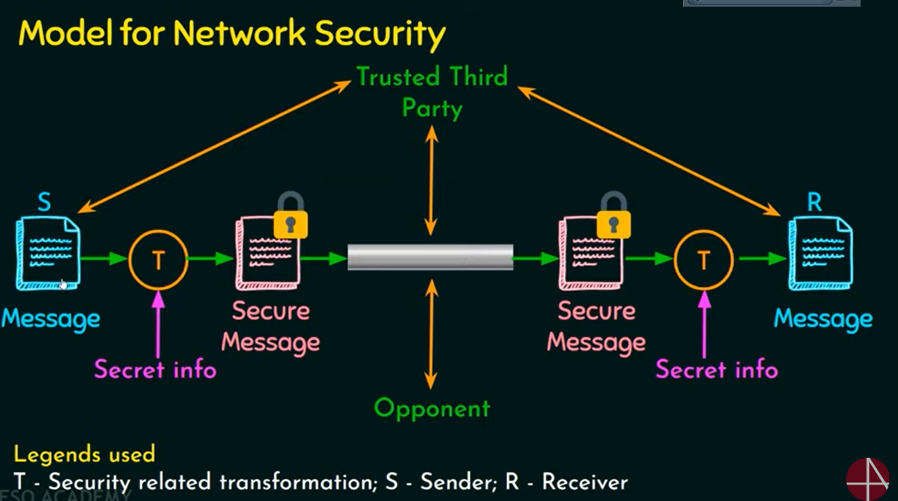
Network Security Model

Slide 9
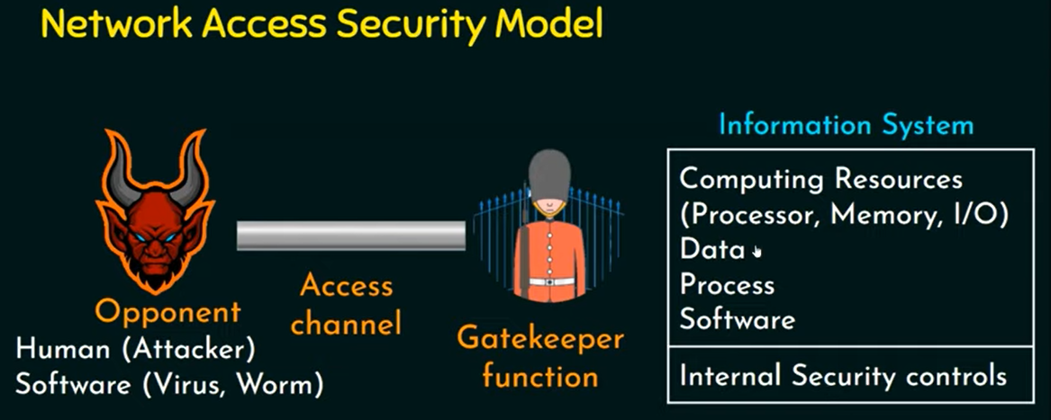
Network Access Security Model

Slide 10
How to Develop a Network Security Model
Key Steps to Developing a Network Security Model
Design an Encryption Algorithm: Choose between symmetric or asymmetric cryptography.
Generate and Manage Keys: Use cryptographically secure methods to create keys.
Distribute and Share Keys: Implement secure key exchange mechanisms.
Specify Protocols: Design communication protocols to handle secure messaging, session initiation, and termination.

Slide 11
02
Cryptography

Slide 12
What is Cryptography
Cryptography is the process of hiding or coding information so that only the person a message was intended for can read it.
Cryptography mainly uses mathematical principles and a series of formulas and algorithms to encrypt messages so that decrypting these messages becomes impossible

Slide 13
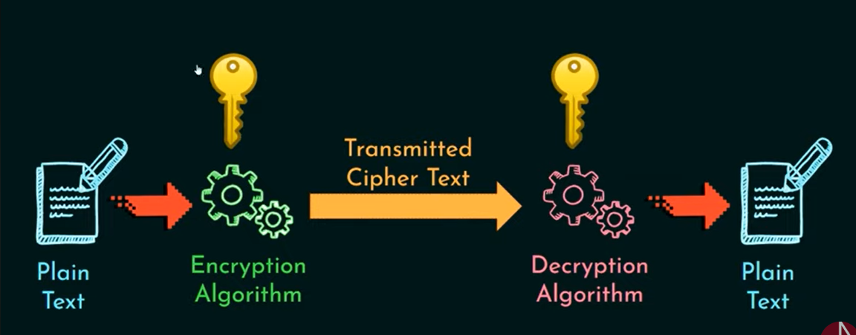
Workflow of Cryptography

Slide 14
Importance of Cryptography
Strong network security models extensively use cryptography and data encryption techniques to safeguard confidential data against cyber attacks.
Models of network security in Cryptography can help address threats like data tampering, impersonation and forgery by leveraging cryptographic authentication mechanisms involving security certificates, keys or signatures.
Modern network security models adopt a defence-in-depth approach with multilayered controls.

Slide 15
Terminology in Cryptography
Plain Text: A readable text which can be understood by all users. The plain text is the message which undergoes cryptography.
Cipher Text: The message obtained after applying cryptography on plain text.
Encryption: The process of converting plain text to cypher text. It is also called encoding.
Decryption: The process of converting cypher text to plain text. It is also termed decoding.

Slide 16
Types of Cryptography
Symmetric key cryptography: It mainly involves using a single key, called a secret key, used for encrypting and decrypting the data.
Asymmetric key cryptography : It involves using two different keys for encrypting and decrypting the data.

Slide 17
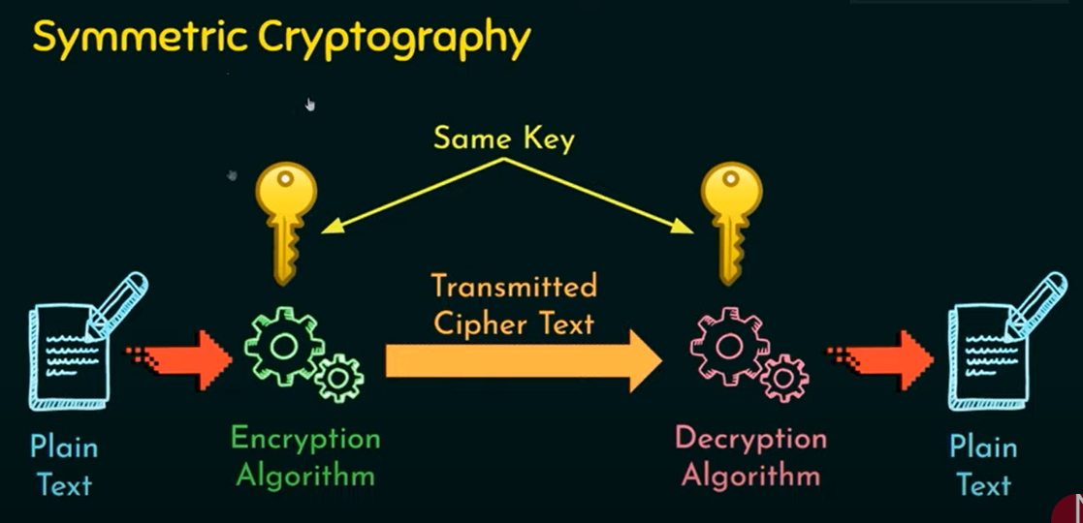
Workflow of Cryptography

Slide 18
03
Practical Exercise

Slide 19

Scenerio
Dave wants to send a secure message to Chad. They’ll use a shared secret key to encrypt and decrypt messages and will use Python to design the Cryptography algorithms.
Simple Secure Messaging System with Caesar Cipher Algorithm

Slide 20
Caesar cipher
Caesar Cipher Technique is a simple and easy method of symmetric key cryptography.
Key Concepts:
Caesar Cipher: A substitution cipher where each letter is shifted by a fixed number (key) in the alphabet.
Key: The number of positions each letter is shifted by (e.g., 3 positions to the right).

Slide 21

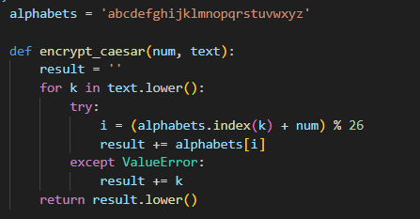

Slide 22


Slide 23
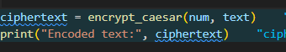

Slide 24
Encrypt the data found in the txt file sent to you using ceasar cypher and a key value of 23. And save it in a new txt file for me to decrypt
Task 1

Slide 25
04
Integrating Encryption into Network Security Models

Slide 26
Encryption in Network Security Models
Data Transmission: Protects data in transit using protocols like TLS.
Stored Data: Encrypting data at rest in databases or file systems.
User Authentication: Passwords and tokens are often protected using encryption.

Slide 27
Best Practices in Developing a Network Security Model
Use Strong Encryption: Choose well-tested algorithms when needed (AES, RSA).
Manage Keys Securely: Use secure key exchange and key management techniques.
Implement Secure Protocols: Use established security protocols (e.g., TLS, SSH).
Monitor and Update: Continuously monitor for vulnerabilities and update the security architecture.

Slide 28
Thanks!
Do you have any questions?
amosmarvellous48@gmail.com
+234 702 625 4613

